Slide 1
Filters 2

Slide 2
What is noise?
Image noise is random (usually unwanted) variation of brightness or colour information in the images captured. It is degradation in image signal and may be caused by several factors, e.g. by long exposures because of the heat produced by the image sensor in the camera.

Slide 3
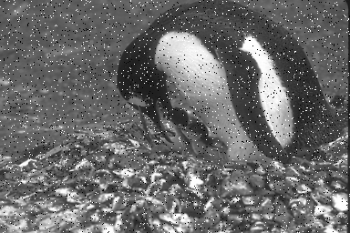
Noise Type 1: Salt and Pepper
The effect is similar to sprinkling white and black dots – salt and pepper – all over the image.
One example where salt and pepper noise arises is in transmitting images over noisy digital links.

Slide 4

Noise Type 2: Gaussian Noise
This type of noise adds more noise to the midtones and less noise to the shadows and highlight regions of the image.
Principal sources of Gaussian noise in digital images arise during acquisition e.g. sensor noise caused by poor illumination and/or high temperature

Slide 5
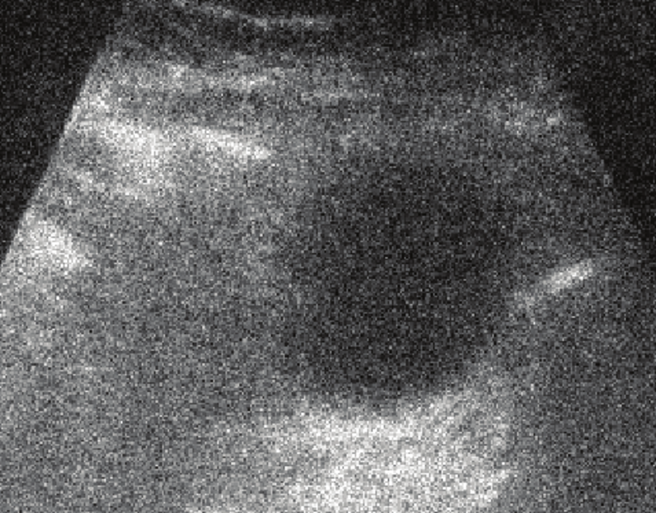
Noise Type 3: Speckle noise
Random values multiplied by pixel values in an image.
Very evident in medical ultrasound images. Images obtained by such imaging system suffer from an interference phenomenon.

Slide 6
Generating Noise
Use an image and try to generate random noise. Display next to each other to better appreciate the differences. The code we need is:
cv2.randn(im,mean,sigma) # create the random distribution
im_noise = cv2.add(img, im) # add the noise to the original image

Slide 7
Solutions?
Image Restoration – how do we restore the image? i.e. how do we remove the noise?
Usually we know what type of errors to expect and the type of noise on the image; hence, we can choose the most appropriate method for reducing the effects
Most of the time we will be dealing with Filters in order to perform such operations. Common filters are the Mean, Gaussian and Median smoothing.

Slide 8
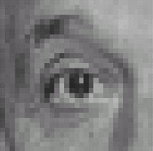
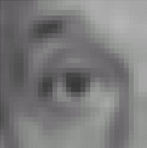

Mean filter (average)
Already covered…
*
1
1
1
=
1
1
1
1
1
1
Original
Blur (with a mean filter)

Slide 9
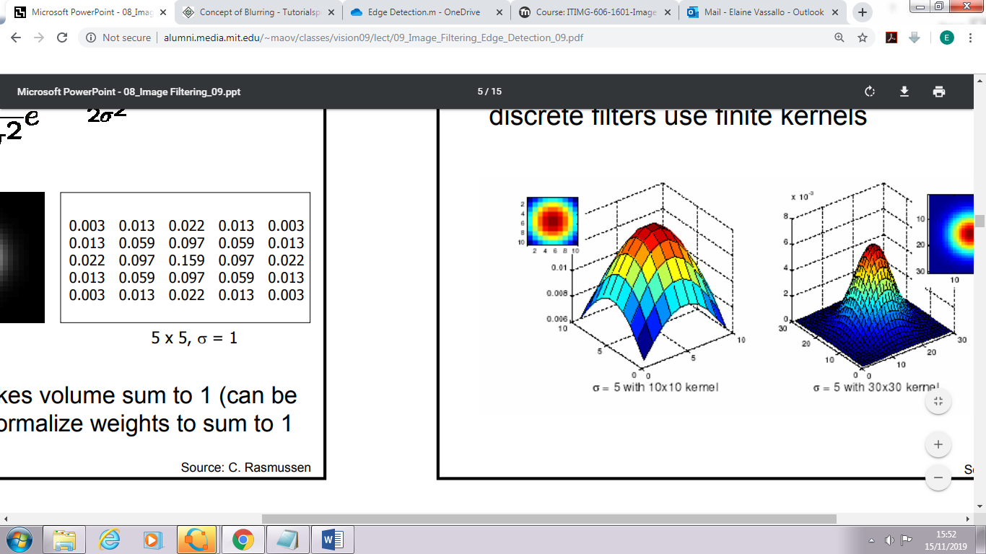
Guassian filter
Already covered…
Gaussian_kernel = 1/16 [1,2,1;
2,4,2;
1,2,1]

Slide 10
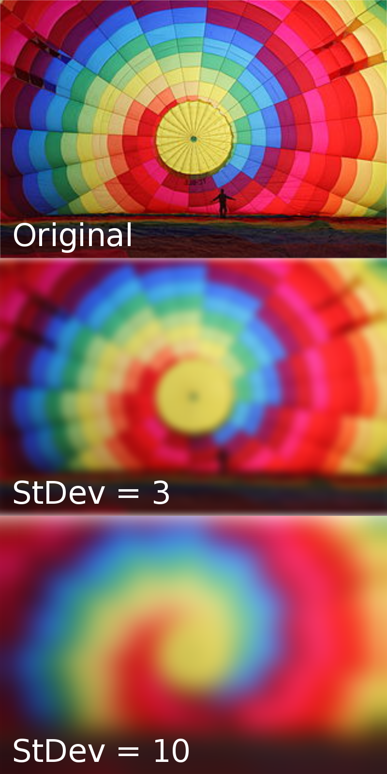
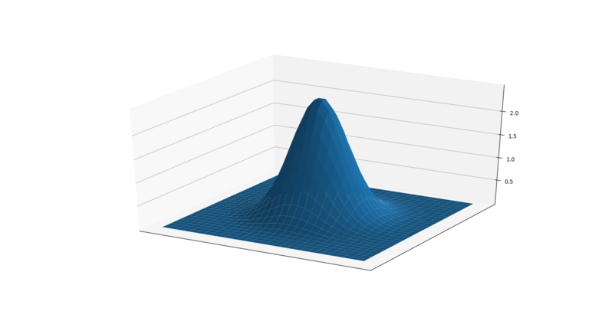

Gaussian blur
In a Gaussian blur, the pixels nearest the center of the kernel are given more weight than those far away from the center.
Larger kernels have more values factored into the average, and this implies that a larger kernel will blur the image more than a smaller kernel.
Sigma (StDev) defines the variance or ‘decay’ of the gaussian curve. It peaks at the center and decays as you move away. The bigger the sigma the slower the decay.

Slide 11
Python OpenCV built-in gaussian blur function
Where :
src- image to blur.
ksize – Kernel size (5x5, 15x15). Has to be in odd numbers.
sigmaX and sigmY – Standard deviation for decay of curve. Larger value = slower decay
….
KernelSize = (15, 15) GaussianBlurImg = cv2.GaussianBlur(src=im_noise, ksize=KernelSize, sigmaX=0, sigmaY=0)

Slide 12
Mean and Gaussian Filters
These work best with Salt & Pepper Noise, and Gaussian noise
BUT they also tend to:
Blur sharp edges, and
Destroy the very fine details in the image
They are called Linear filters (can be done by sliding the kernel)

Slide 13
Non-Linear Filters
Advantage over linear filters
Can preserve edges
Can be difficult to design, but thankfully OpenCV provides ready in-built methods e.g. Bilateral filter

Slide 14
Median Filters
A relatively simple non-linear filter
The median filter considers each pixel in the image in turn and looks at its nearby neighbours to decide whether or not it is representative of its surroundings. Instead of simply replacing the pixel value with the mean of neighbouring pixel values, it replaces it with the median (middle) of those values.

Slide 15
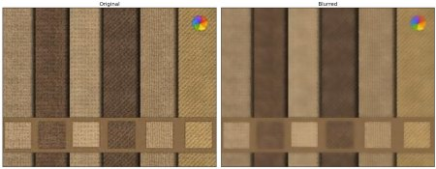
Bilateral filter
A bilateral filter is a non-linear, edge-preserving, and noise-reducing smoothing filter for images. It replaces the intensity of each pixel with a weighted average of intensity values from nearby pixels. This weight can be based on a Gaussian distribution.
cv2.bilateralFilter(), is highly effective at noise removal while preserving edges.

Slide 16
Worksheet Intro
Use an image with salt & pepper noise and apply the 3 different types of noise removal techniques we learnt about.
Display the results labelled and in a single figure, to enable comparison.

Slide 17
Questions?

